Slide 1

Character Counter Program: Waterfall Model
Create a Python program that counts characters in a sentence using regex, following the Waterfall Model.
Rahimjon Komiljonov

Slide 2





Step 1: Requirement Analysis
User Input
Ask for sentence, allow quit with 'q'
Character Counting
Count vowels, consonants, numbers
Display Results
Show counts for each category
Error Handling
Handle empty input with prompt

Slide 3
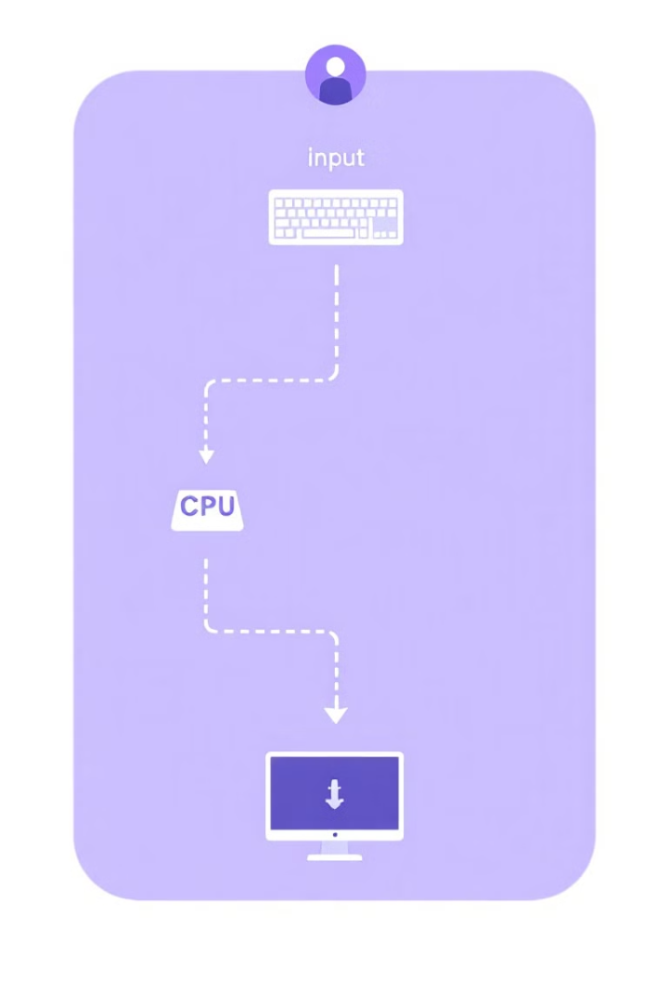

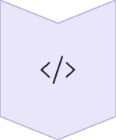


Step 2: System Design
Input Collection
Use input() function
Processing
Use regex patterns, store in dictionary
Output Display
Print results to user
Loop
Continue until user quits

Slide 4

Step 3: Implementation
Regex Patterns
Count Function
Use patterns for vowels, consonants, numbers
Process sentence, return dictionary of counts
Main Loop
Ask for input, display results, handle quit

Slide 5

Step 4: Testing
Test Scenario
Input
Expected Output
Mixed characters
Hello123!
Vowels: 3, Consonants: 2, Numbers: 3
Only numbers
987654
Numbers: 6, Others: 0
Empty input
(Enter)
Prompt message
Quit program
q
Thank you message

Slide 6



Step 5: Deployment
Finalize Code
Clean up and optimize
Package Script
Prepare for distribution
Release
Make available to users

Slide 7








Step 6: Maintenance
Looping
GUI
Allow restart without quitting
Add Tkinter interface
Error Handling
Special Characters
Add checks for invalid patterns
Count additional character types

Slide 8










Waterfall Model Complete Cycle
Design
Requirements
Plan program structure
Define program functionality
Implementation
Write Python code
Deployment
Deliver for use
Testing
Verify correct outputs

